Slide 1
Individual Project:
Fanfiction storage & music player
By Kyle McPherson

Slide 2
The Premise
When we were given our project specifications, I decided to make something that would actually be useful to me in the long run.
In the end I came up with an application that would store my favourite music, fanfiction authors and stories.

Slide 3
The Beginning
Must:
working front end with crud functionality interfaces
working java back end to process and pass information on alongside crud functionality
working database to store data
should:
store information on fanfiction
store information on music
could:
link to fanfiction story/most recent chapter
play song selected
would:
add ability to navigate to any chapter through a story
add playlist functionality
update when a story updates
update how many songs are in designated folder, alongside automatic detail filling
To begin with, I wrote up a Moscow list, detailing my goals for the project.

Slide 4
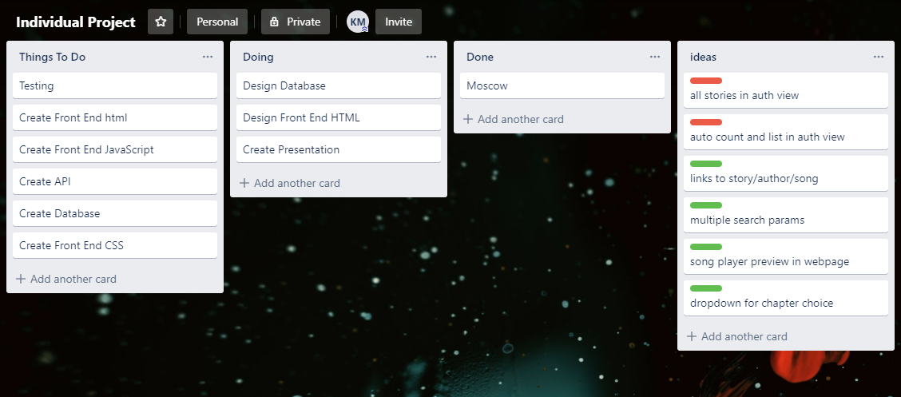
The Progression
To note my progress throughout the project, I created a trello board to help keep track of what I have completed, and what I have yet to finish.

Slide 5
User Stories
As a user, I want to be able to add new songs
As a user I want to be able to search through songs with different parameters
As a user I want to edit the songs details
As a user I want to play my songs on the browser
As a user I want to delete unwanted songs
As a user, I want to be able to add new authors
As a user I want to be able to search through authors with different parameters
As a user I want to edit the authors details
As a user I want to open a new tab to an authors homepage
As a user I want to delete unwanted authors
As a user, I want to be able to add new stories
As a user I want to be able to search through authors with different stories
As a user I want to search through different stories by the author who wrote them
As a user I want to edit the stories details
As a user I want to open a new tab to any chapter within the story
As a user I want to delete unwanted stories

Slide 6
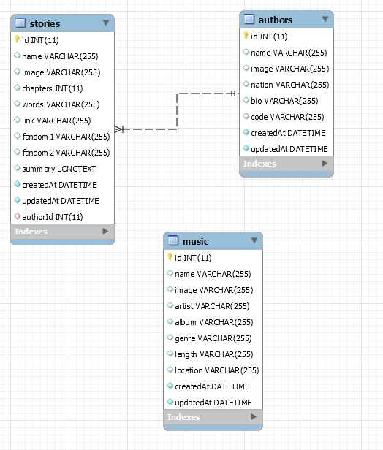
The Database
Next I created a list of my intended database tables, fields and relationships and created an ERD(entity relationship diagram) of my database.

Slide 7
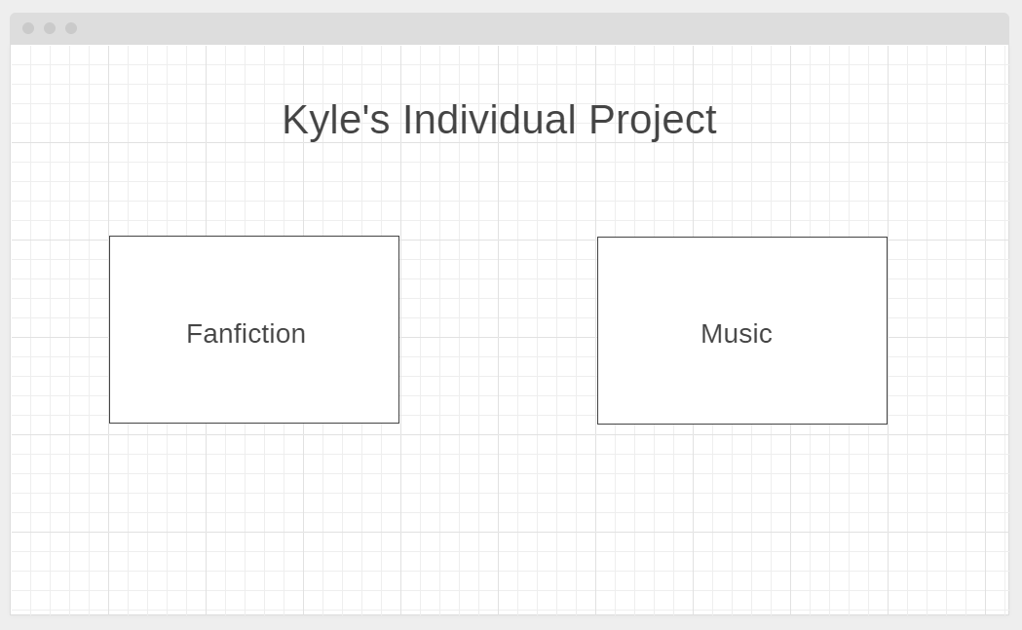
The design
The homepage:
Now I had reached the stage where I was creating a basic wireframe. I ended up with eighteen pages, this was not perfectly followed, but the later designs were made with this in mind.

Slide 8
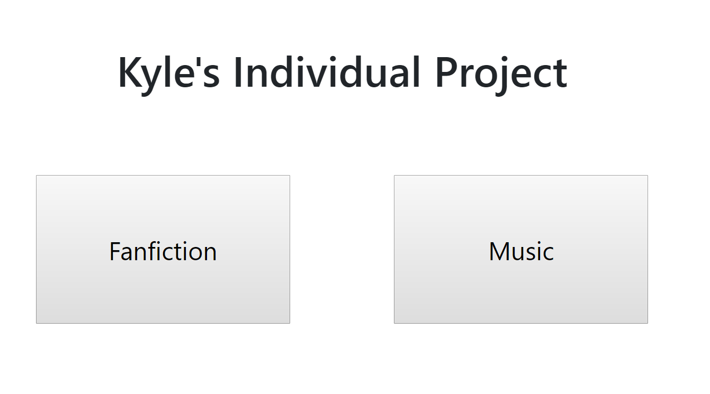
The Development
The homepage:
At this point, I started creating the application. This was done by progressing one page at a time, doing the functionality, with very little css.

Slide 9
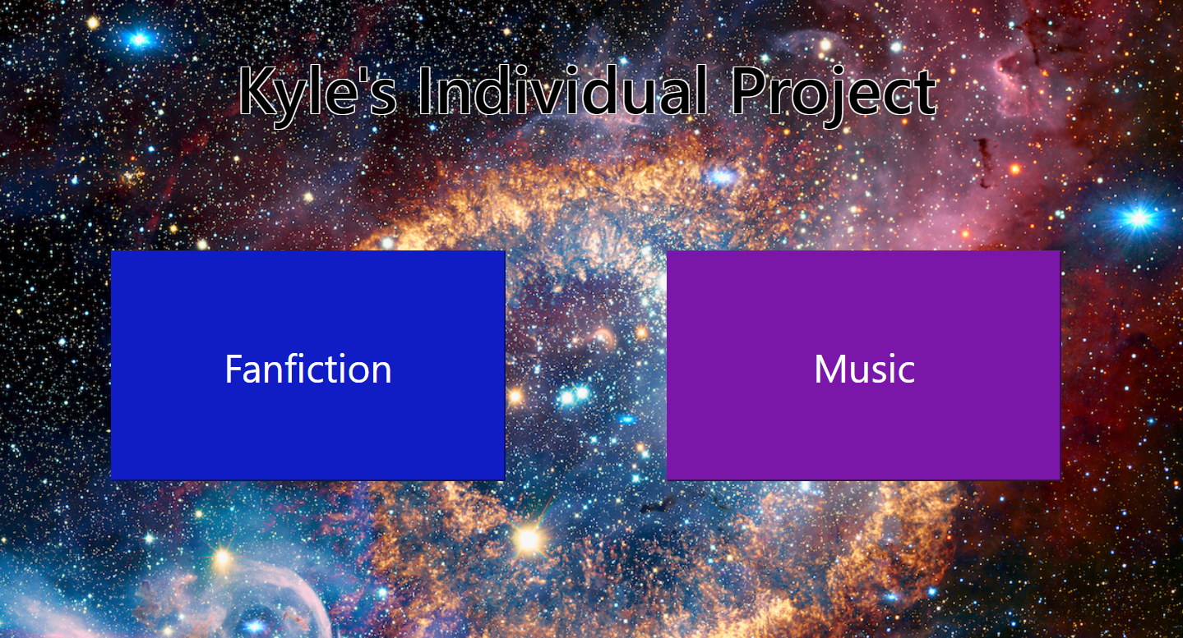
The Refinement
The homepage:
Nearly finished, I started working on prettying it up.
I did this using a combination of bootstrap and using the styles file.

Slide 10
The Testing
Finally, I am getting around to testing.
After going through manually testing everything, I got my automated testing done. This testing included making sure I could navigate to all of my pages, and throwing an error when I go to a branch that doesn’t exist.
Next I tested my crud functionality, for all three tables. Making sure the database functions properly.

Slide 11

The Next Steps
On the next sprint, there would be a few things I may think to fix or add.
One fix: when you only enter one fandom into the story on creation, the ampersand still appears as if there were two fandoms:
One Feature: when you select a site for the author, it automatically uses that site to link the story, instead of needing to choose the stories site manually on creation.

Slide 12
Any Questions?

